Slide 1

Project Presentation
CS435/635 Deep Learning
English to Hindi Machine Translation using Transformer
Submitted To-
Dr. Chandresh Kumar Maurya
Course Coordinator
Submitted By-
Kuldeep Pathak
PHD (2301101009)
Amit Singh Yadav
PHD (2301201001)

Slide 2
Table of Contents
Introduction
Motivation
Objective
Methodology
Dataset & Transformer Architecture
Conclusion
References
Result

Slide 3
Introduction
Machine Translation (MT) is the automated process of translating text.
English and Hindi are widely spoken languages with distinct linguistic characteristics.
It provides us the opportunity to explore and implement the Transformer architecture.
Transformer model shows promising results compared to traditional statistical machine translation and other neural machine translation models. ³

Slide 4
Motivation
Hands-On Learning Opportunity.
Transformer's Adaptability to Sequences.
Understanding Attention Mechanisms.
Challenges of Cross-Linguistic Translation.

Slide 5
Objective
Implement Transformer Network
Explore Sequence-to-Sequence Translation
Leverage Attention Mechanisms
Enhance Understanding of Language Processing

Slide 6
Methodology
Data Preparation
Used Positional Encoding
Model Architecture
Encoder
Tokenizer
Decoder

Slide 7
Methodology
Training
Evaluation
Optimization and Fine tuning
Run multiple times by changing the hyperparameter
Split dataset into 70% Training and 30% for testing
Observe Training and Testing loss

Slide 8
Dataset
Used a dataset from Kaggle².
The dataset contains more than 130000 records.
The dataset is prepared using the corpus and scrapping the web.
The shape of dataset is:
130476 Row
2 Column
Used only 100000 records.
English to Hindi Text

Slide 9
Transformer Components
Embedding Layer
Encoder and Decoder Stacks
Attention Mechanism
Positional Encoding
Feed-Forward Neural Networks

Slide 10
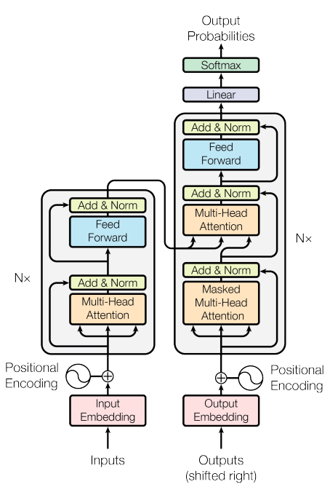
Transformer Architecture
Main Component
Self-Attention Mechanism
Multi-Head Attention
Encoder and Decoder Stacks
Figure 1. Attention Architecture¹

Slide 11
Transformer Architecture (contd.)
Main Component
Positional Encoding
Feed-Forward Neural Networks
Figure 1. Attention Architecture¹

Slide 12
Result
Experimental Setup:
Hyperparameters:
Batch Size: 16
Learning Rate: 0.01
Max Input Length: 512
Max Output Length: 512
Training Epochs: 25
Adam optimizer
Cross Entropy Loss
AutoTokenizer from the pretrained "Helsinki-NLP/opus-mt-en-hi"
P100 GPU

Slide 13
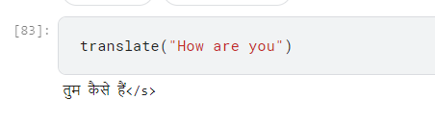
Result
Train Loss: 1.8217
Test Loss: 1.6819
The model demonstrates a decreasing trend in both train and test loss.
Figure 2. Final Output

Slide 14
Conclusion
Comprehensive Understanding
Effective Utilization
Optimization and Fine-Tuning
Practical Application

Slide 15
References
Vaswani, Ashish, et al. "Attention is all you need." Advances in neural information processing systems 30 (2017).
https://www.kaggle.com/datasets/preetviradiya/english-hindi-dataset
Watve, Abhinav Y., and Madhuri A. Bhalekar. "English to hindi translation using transformer." 2023 International Conference on Innovative Data Communication Technologies and Application (ICIDCA). IEEE, 2023.

Slide 16

Thank You

